Slide 1
Submitted to : Sir asif sohail
GROUP 5
BCSF18M003
BCSF18M006
BCSF18M021
BCSF18M030

Slide 2
DATA WAREHOUSING

Slide 3
Introduction:
Data warehouses are clearly here to stay; they are no longer regarded as an optional part of the database “armory” for many businesses.
The increasing popularity of data warehouses is thought to be driven by a range of factors, including, for example, government regulatory compliance that requires businesses to maintain transactional histories and cheaper.

Slide 4
Evolution of Data Warehousing:
Since the 1970s, organizations have mostly focused their investment
In recent times, when such systems are commonplace, organizations are focusing on ways to use operational data
Operational systems were never designed to support such business activities

Slide 5
Data Warehousing Concepts

Slide 6
Data Warehousing Concepts:
“A subject-oriented, integrated, time-variant, and nonvolatile collection of data in support of management’s decision-making process.”
In this early definition by Inmon (1993), the data is:
Subject-oriented
Integrated
Time-variant
Non-volatile

Slide 7
Benefits of Data Warehousing:
Potential high returns on investment
Competitive advantage
Increased productivity of corporate decision makers

Slide 8
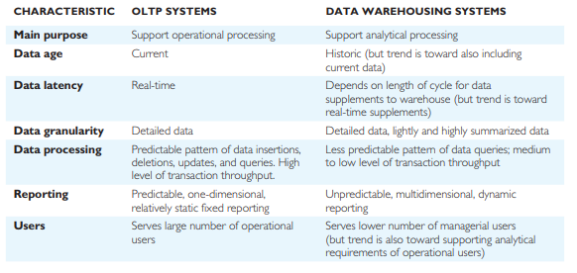
Comparison of OLTP Systems and Data Warehousing:
A DBMS built for OLTP is generally regarded as unsuitable for data warehousing, because each system is designed with a differing set of requirements in mind.
OLTP systems are not built to quickly answer ad hoc queries. They also tend not to store historical data, which is necessary to analyze trends. Basically, OLTP offers large amounts of raw data, which is not easily analyzed.

Slide 9
Problems of Data Warehousing:
The problems associated with developing and managing a data warehouse are listed:
Underestimation of resources for data ETL
Hidden problems with source systems
Required data not captured
Increased end-user demands
Data homogenization
High demand for resources
Data ownership
High maintenance
Long-duration projects
Complexity of integration

Slide 10
Real-Time Data Warehouse:
The major problems faced by the developers of RT/NRT data warehouses identified by Langseth (2004) include:
Enabling RT/NRT extraction, transformation, and loading (ETL) of source data
Modeling RT fact tables
OLAP queries versus changing data
Scalability and query contention

Slide 11
Data Warehouse Architecture

Slide 12
Data Warehouse Architecture:
Operational Data
Operational Data Store
ETL Manager
Warehouse Manager
Query Manager
Detailed Data
Lightly and Highly Summarized Data
Archive/Backup Data
Metadata
End-User Access Tools

Slide 13
Data Warehousing Tools and Technologies

Slide 14
Extraction, Transformation, and Loading (ETL)
Extraction
Transformation
Loading Data
Data profiling and data quality control
Metadata management

Slide 15
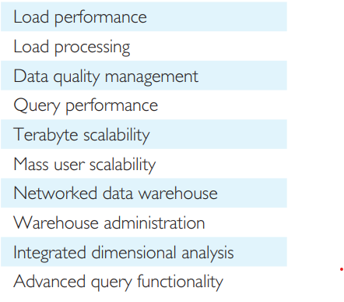
Data Warehouse DBMS
Requirements for data warehouse DBMS

Slide 16
Parallel DBMS
There are two main parallel hardware architectures commonly used as database server platforms for data warehousing:
Symmetric multiprocessing (SMP): A set of tightly coupled processors that share memory and disk storage.
Massively parallel processing (MPP): A set of loosely coupled processors, each of which has its own memory and disk storage.

Slide 17
Data Warehouse Metadata
Focus on the integration of metadata, that is “data about data”.
Major purpose of metadata is to show the pathway back to where the data began,
Metadata associated with data management describes the data as it is stored in the warehouse.
Metadata described previously is also required by the query manager to generate appropriate queries.
Metadata associated with the users of queries that includes, for example, information describing what the term “price” or “customer” means in a particular database and whether the meaning has changed over time
Synchronizing metadata There were two major standards for metadata and modeling in the areas of data warehousing and component-based development proposed by the Meta Data Coalition (MDC) and the Object Management Group (OMG).

Slide 18
Administration and Management Tools
Monitoring Data Loading from Multiple Sources;
Data Quality and Integrity Checks;
Managing and Updating Metadata;
Monitoring Database Performance to Ensure Efficient Query Response Times and Resource Utilization;
Auditing Data Warehouse Usage to Provide User Chargeback Information;
Replicating, Sub setting, And Distributing Data;
Maintaining Efficient Data Storage Management;
Purging Data;
Archiving and Backing Up Data;
Implementing Recovery Following Failure;
Security Management.

Slide 19
DATA MART

Slide 20
DATA MART:A database that contains a subset of corporate data to support the analytical requirements of a particular business unit (such as the Sales department) or to support users who share the same requirement to analyze a particular business process (such as property sales).
Reasons for Creating a Data Mart
To give users access to the data they need to analyze most often.
To provide data in a form that matches the collective view of the data by a group
of users in a department or group of users interested in a particular business process.
To improve end-user response time due to the reduction in the volume of data to be accessed.
To provide appropriately structured data as dictated.
Data marts normally use less data, so the data ETL process is less complex.
The cost of implementing data marts is normally less than that required to establish an EDW.
The potential users of a data mart are more clearly defined
It can be more easily targeted to obtain support for a data mart project rather than an EDW project.

Slide 21
Data Warehousing and Temporal Databases

Slide 22
Temporal Data:
Data that changes over time
Temporal Database:
A database that contains time-varying historical data with the possible inclusion of current and future data and has the ability to manipulate this data

Slide 23
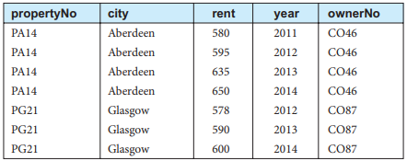
Case 1
Rent remain constant for the whole year:
In this case for the non-temporal transaction database, there is no need to associate time with the PropertyForRent table as the rent column always stores the current value that is used for all live database applications. If all property rents are updated on the same day and remain fixed for that year, the identification of valid rental values is relatively straightforward requiring an association of each value with a value to identify the year.
This scenario allows for the identification of {propertyNo, year} as the primary key for the copy of the PropertyForRent table in the data warehouse.

Slide 24
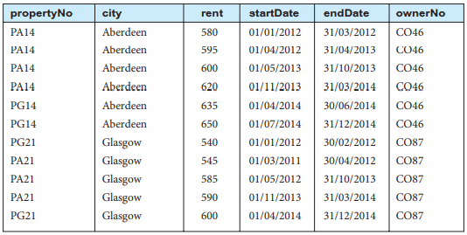
Case 2
Rent can change at any time of the year:
Assume that the rent for each property can be changed at any time throughout a given year to attract potential clients. This scenario is more complex when considering analysis of temporal data in the data warehouse. This scenario requires the identification of {propertyNo, startDate, endDate} as the primary key. To support the management of data that changes over time, temporal databases use two independent time dimensions called valid time (also known as application or effective time) and transaction time (also known as system or assertive time) for maintaining the data.

Slide 25
Temporal Extensions to the SQL Standard

Slide 26
• T180 system-versioned tables
• T181 application-time period tables
System-versioned tables
System-versioned tables are tables that contain a PERIOD clause with a predefined period name (SYSTEM_TIME) and specify WITH SYSTEM VERSIONING. System-versioned tables must contain two additional columns: one to store the start time of the SYSTEM_TIME period and one to store the end time of the SYSTEM_TIME period.
Application-time period tables
The requirement for application-time period tables is that the table must contain two additional columns: one to store the start time of a period associated with the row and one to store the end time of the period.

Slide 27
Data Warehousing Using Oracle
Oracle, which are particularly aimed at supporting data warehousing applications. These features include: • Summary management; • Analytical functions; • Bitmapped indexes; • Advanced join methods; • Sophisticated SQL optimizer; • Resource management.

